Slide 1
32-bit RISC-V CPU Design
Review and discussion session – August 13th 2023
32-bit RISC-V Core in one sight
5 stage pipeline
I-M-F Extensions
“F” Extension is Replaced with “Fixed-Point”
Approximate Multiplication Unit
Controlled by a Special Purpose Register
7-Error control bits (128 different accuracies)

Slide 2
“NAME” CPU Block Diagram:
Control Unit
Fetch Unit
PC
IF
Instruction Decoder
ID
EX
ALU
Immediate
Generator
Memory Interface
Instruction Memory
Integer
Register File
Fixed Point
Register File
APX MUL
Instruction Memory
SQRT
Hazard Detection & Forwarding Unit

Slide 3
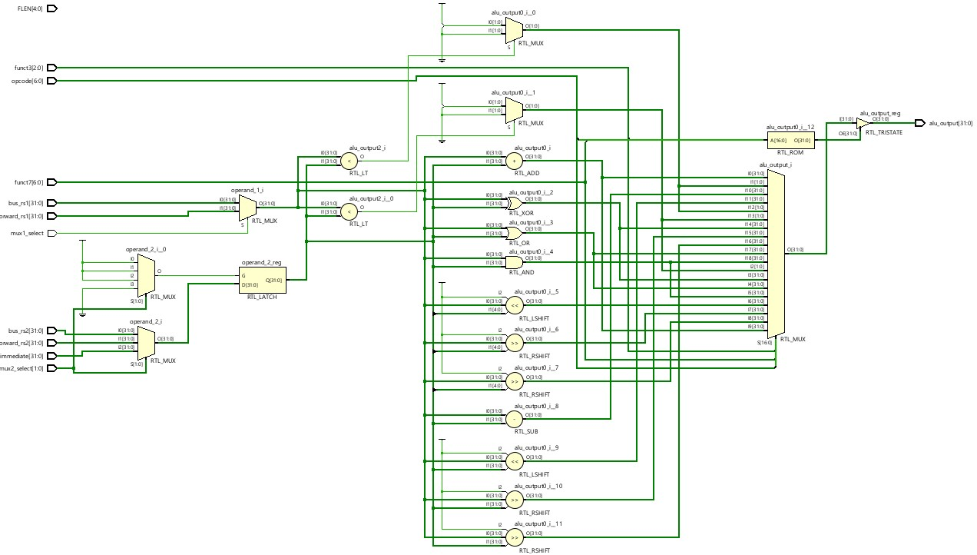
Arithmetic Logic Unit:
Note: Images are taken from RTL Elaborated Design in Xilinx Vivado after synthesis process

Slide 4
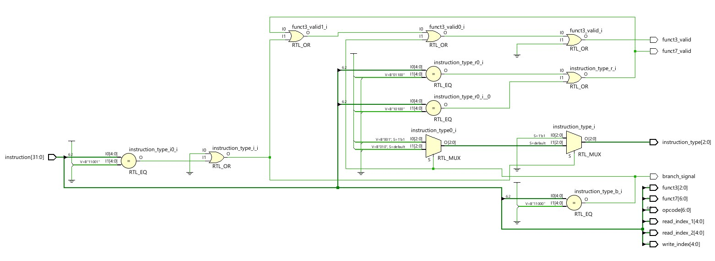
Instruction Decoder:
Note: Images are taken from RTL Elaborated Design in Xilinx Vivado after synthesis process

Slide 5
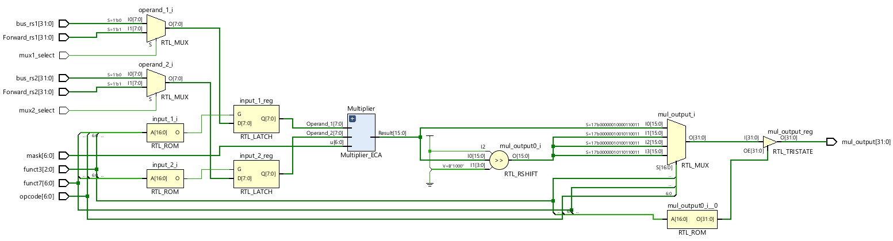
Multiplier Unit:
Note: Images are taken from RTL Elaborated Design in Xilinx Vivado after synthesis process

Slide 6
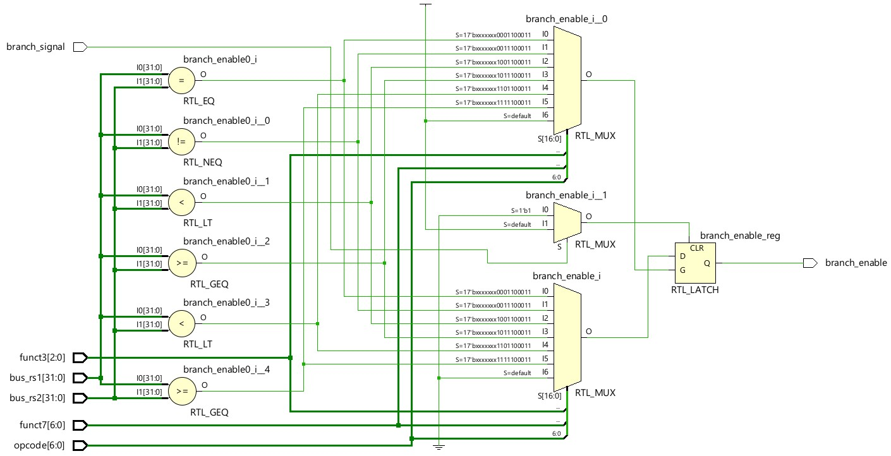
Branch Unit:
Note: Images are taken from RTL Elaborated Design in Xilinx Vivado after synthesis process

Slide 7
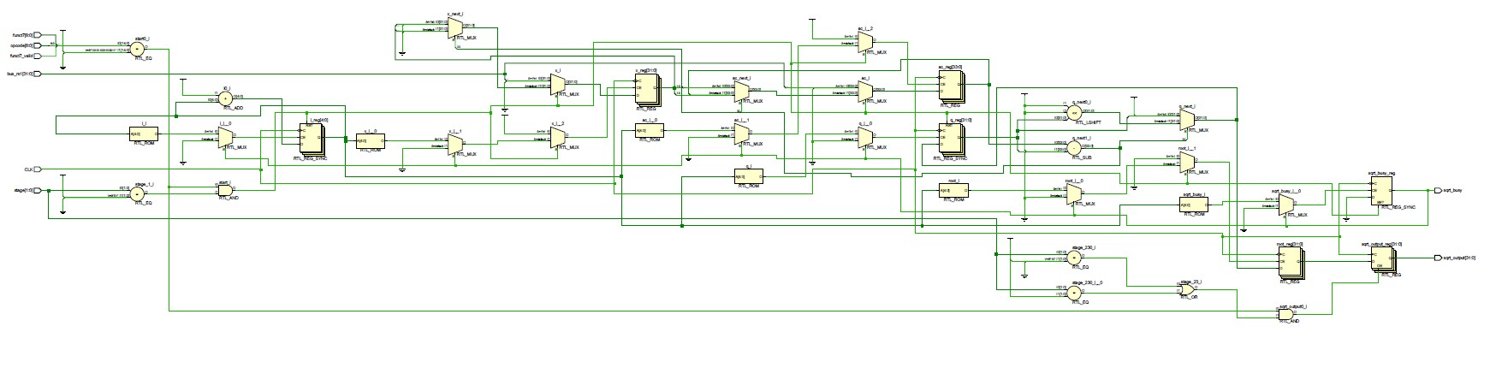
SQRT Unit:
Note: Images are taken from RTL Elaborated Design in Xilinx Vivado after synthesis process

Slide 8
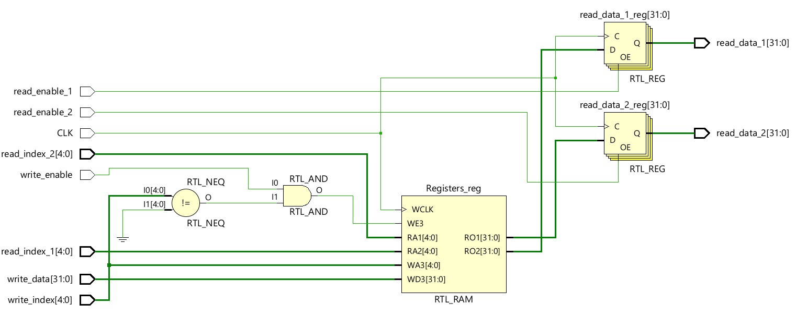
Register File:
Note: Images are taken from RTL Elaborated Design in Xilinx Vivado after synthesis process

